Slide 1
8/24/2022
Introduction to biological macromolecules
Exercise 2: Structural visualization with py3DMol

Slide 2
Biological Macromolecules
This lecture is intended to help you achieve the following learning objectives:
Recall the main types of biological macromolecules, identify their monomers, and describe their levels of structure.
Describe the types of forces that maintain the structure of biological macromolecules and stabilize their interactions with small organic molecules.
It will be about how biological macromolecules
are heteropolymers
are folded
have noncovalent interactions with many drugs
At the end of this mini-lecture, you should be able to answer the following questions:
What are biological macromolecules made of?
What does it mean for a biological macromolecule to be folded?
How do most drugs interact with their targets?

Slide 3
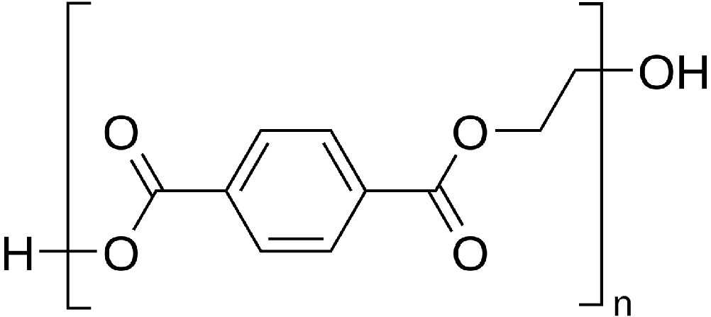
Biological macromolecules are heteropolymers
Polymers - made of smaller building blocks - monomers - that are covalently joined together
Homopolymers - monomers repeat, e.g. in a plastic
Heteropolymers - monomers do not exactly repeat
Different types of macromolecules are made of different types of building blocks
Polyethylene terephthalate, a homopolymer
https://commons.wikimedia.org/wiki/File:Polyethyleneterephthalate.svg

Slide 4
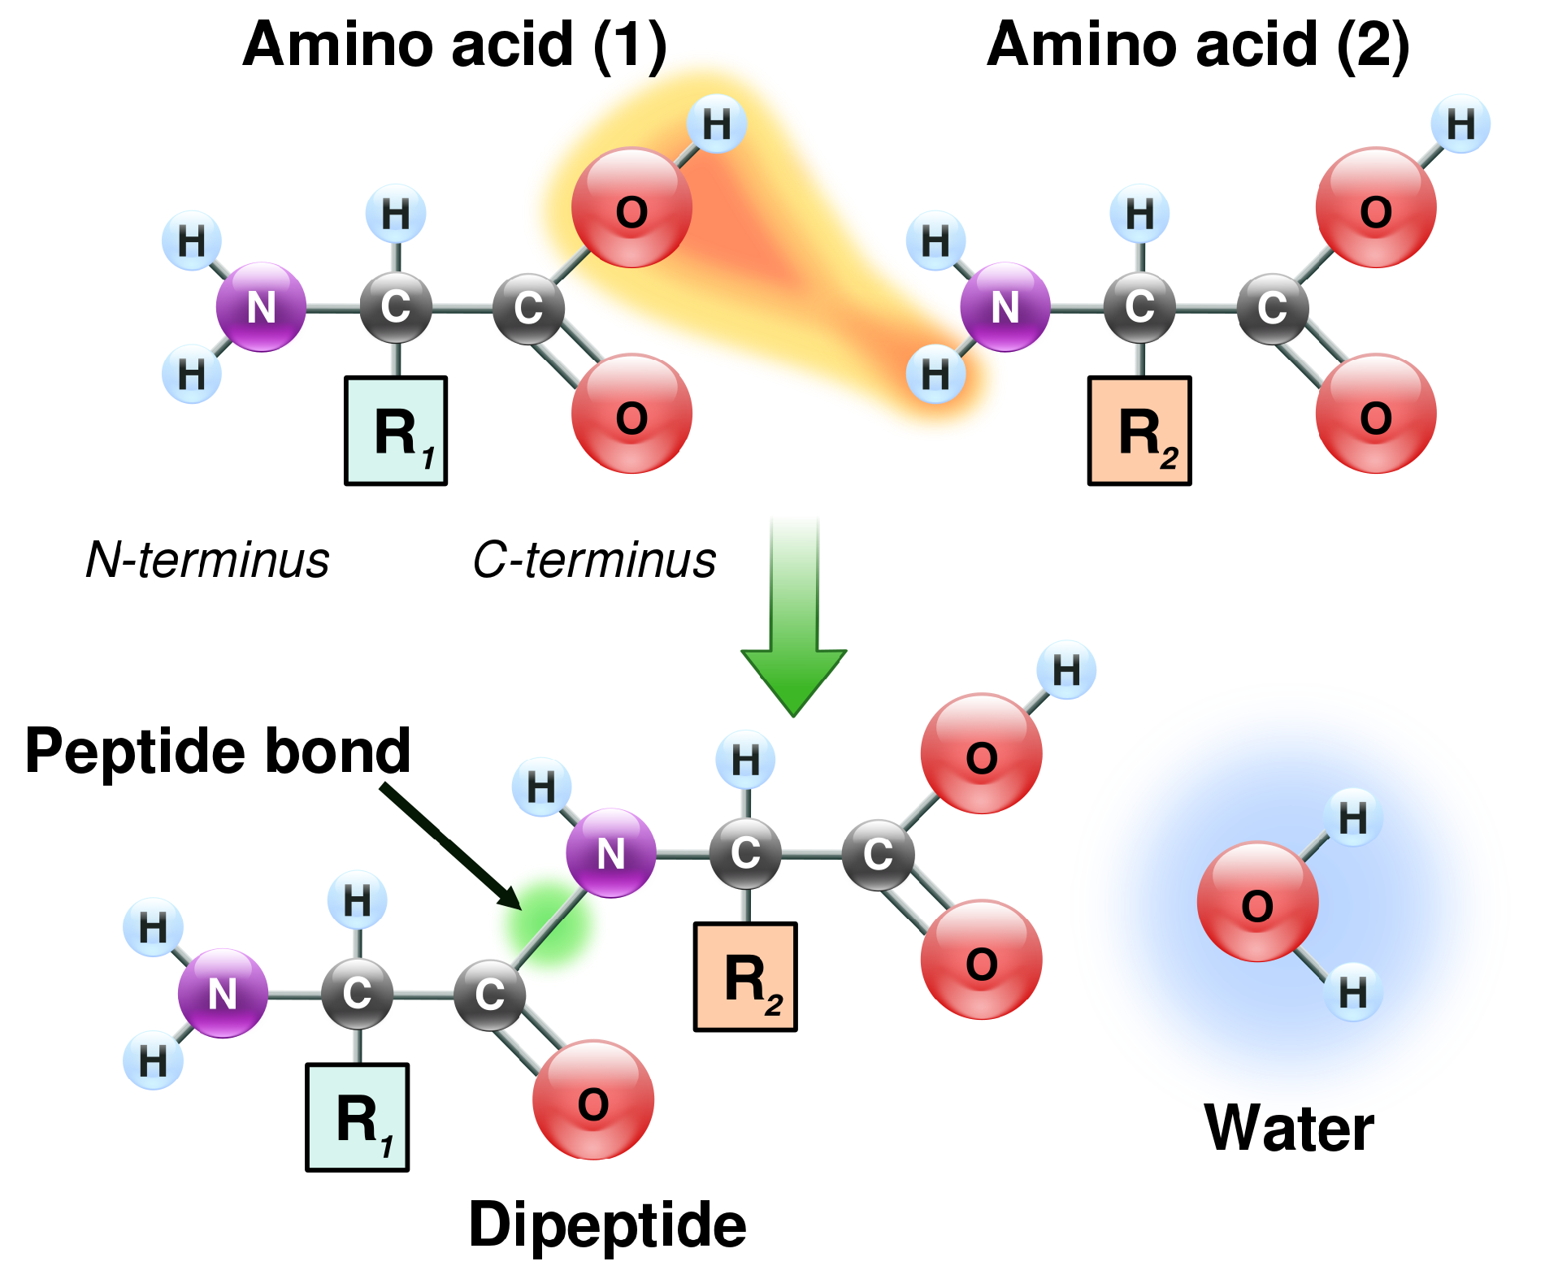
The monomers are small organic molecules
Proteins are made of
20 standard amino acids
linked by peptide bonds
modifications, e.g.
post-translational modification
disulfide bonds
cofactors and prosthetic groups

Slide 5
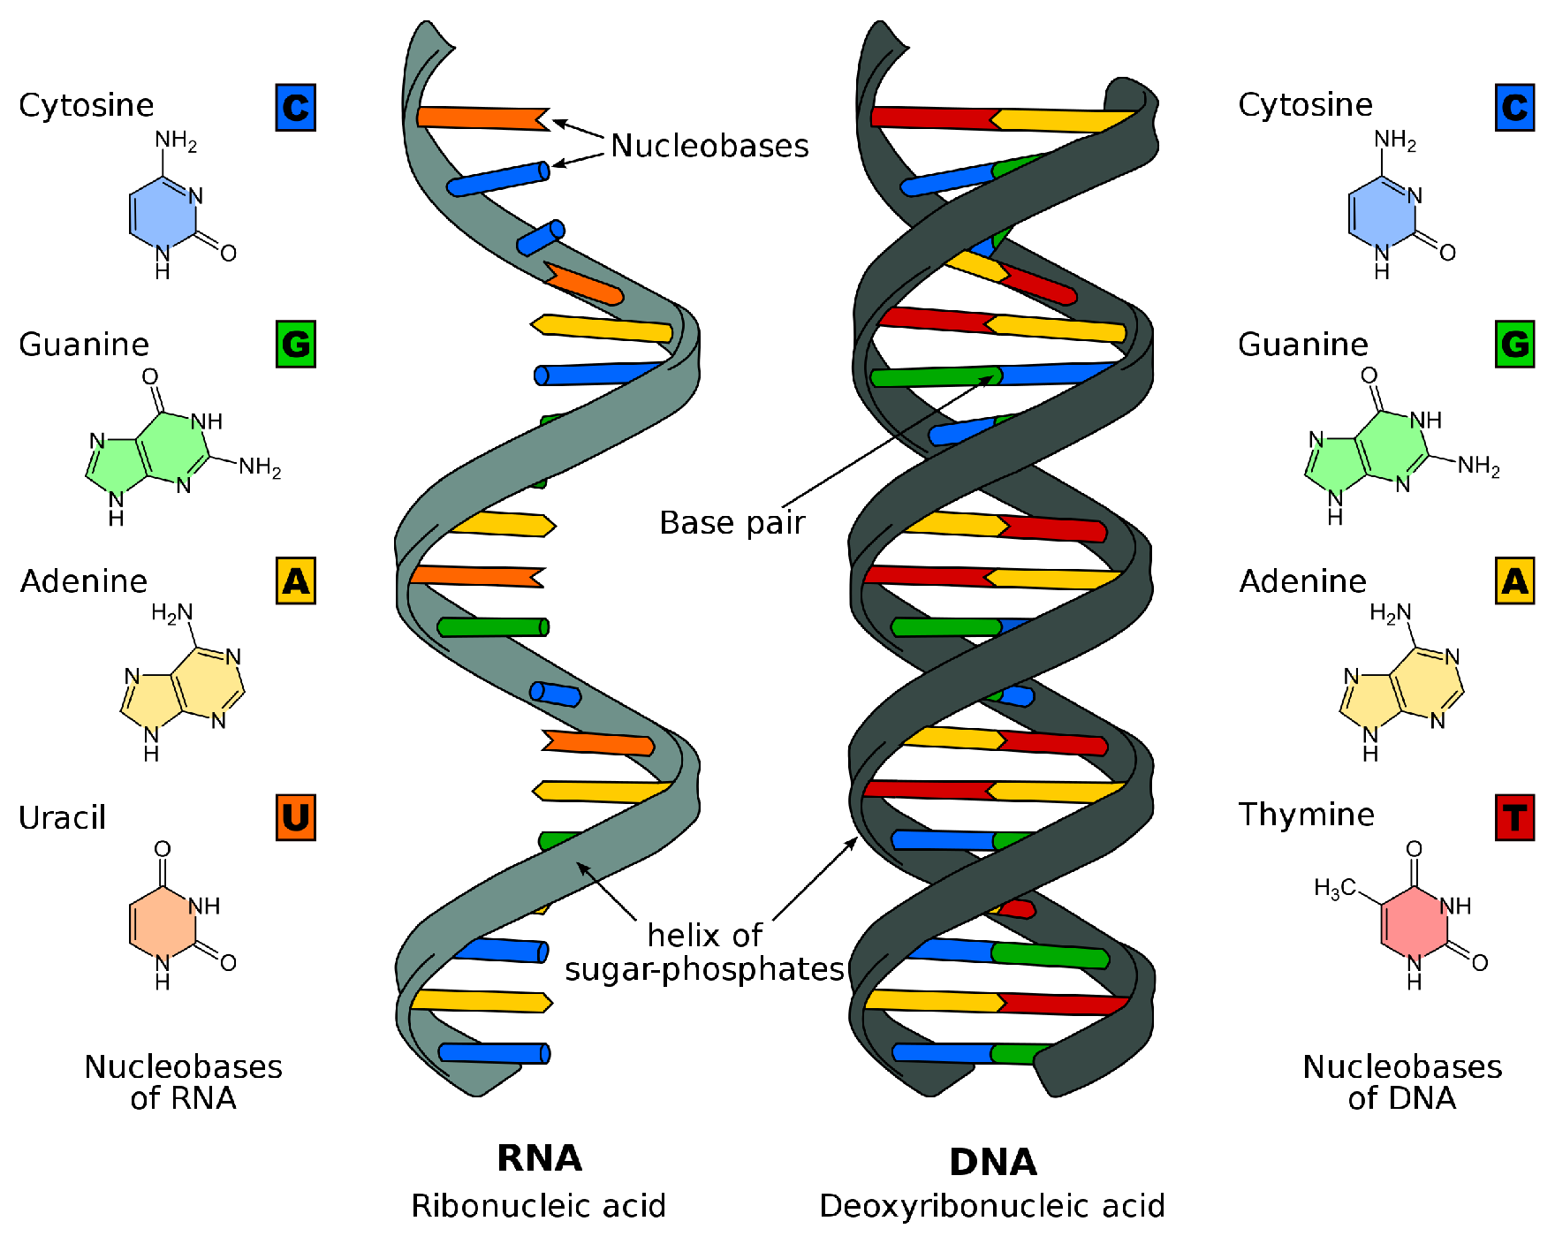
The monomers are small organic molecules
DNA and RNA are made of nucleic acids
DNA usually forms a double helix
RNA is more flexible and can have complex structure
Which can have catalytic activity? DNA or RNA?
https://en.wikipedia.org/wiki/Nucleic_acid#/media/File:Difference_DNA_RNA-EN.svg

Slide 6
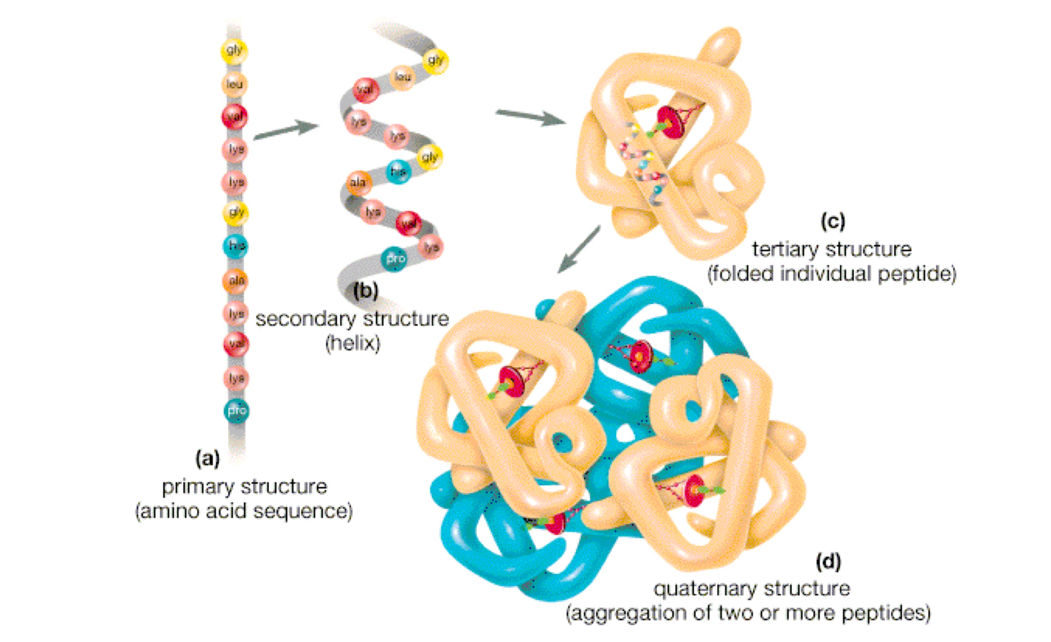
There are four levels of protein structure
https://www.slideshare.net/SabahatAli9/protein-structure-levels

Slide 7
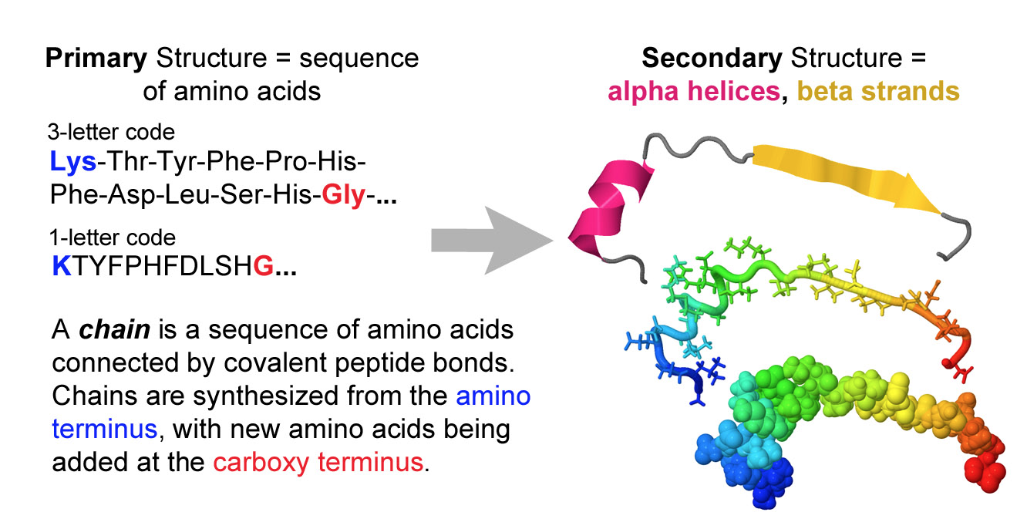
The primary structure is the monomer sequence
https://proteopedia.org/wiki/index.php/Four_levels_of_protein_structure

Slide 8
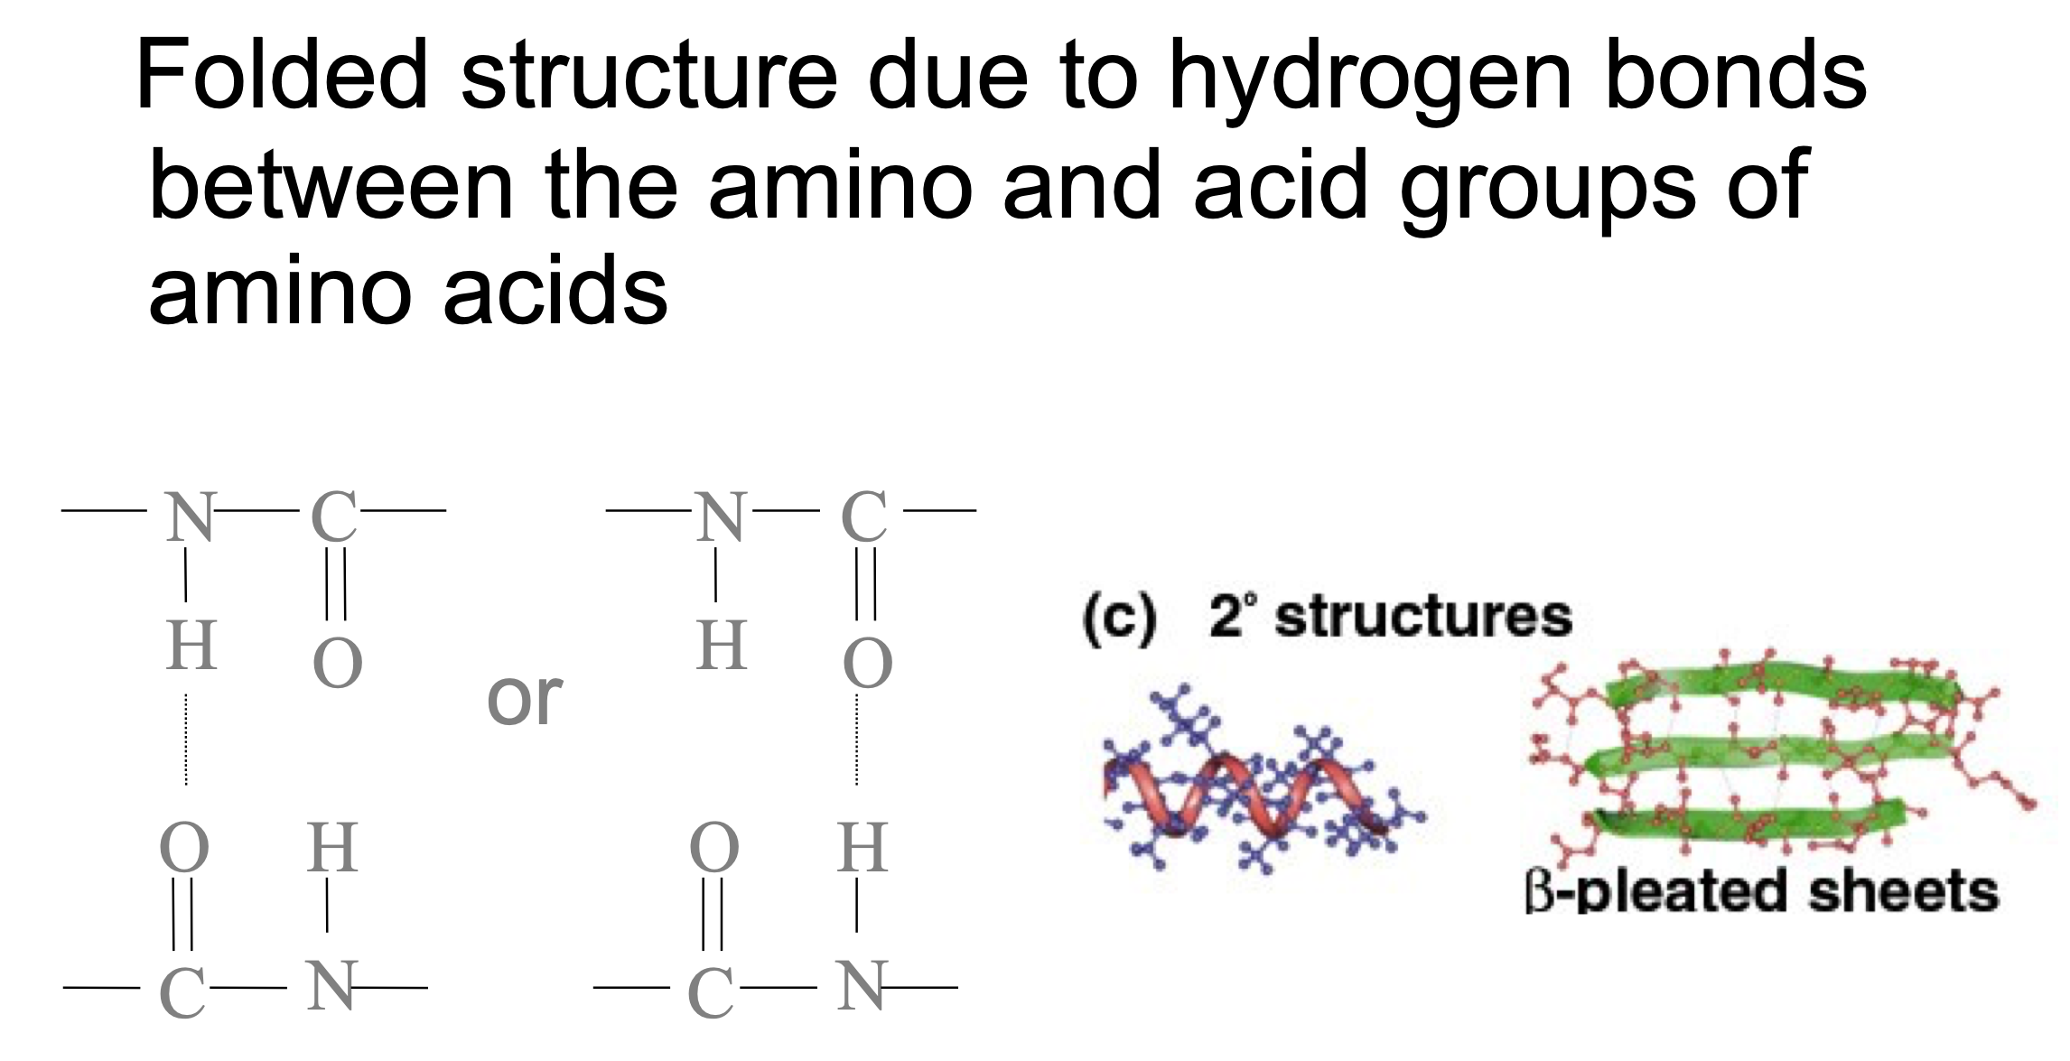
Many sequences have secondary structure
https://www.slideshare.net/SabahatAli9/protein-structure-levels
https://proteopedia.org/wiki/index.php/Four_levels_of_protein_structure

Slide 9
Proteins often form folded tertiary structures
HIV protease
“Ribbon” view showing backbone, emphasizing α helices and β sheets
“Licorice” view showing all heavy atoms
http://www.rcsb.org/3d-view/2HB2
“Folded” does not mean that they are completely rigid, but they are fairly well-defined.

Slide 10
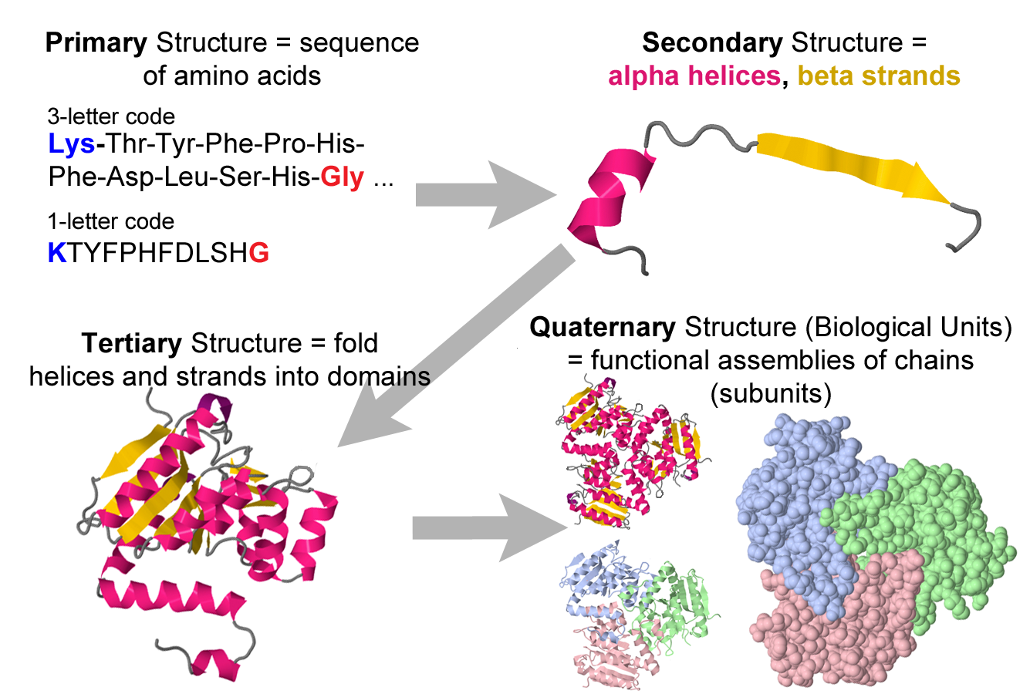
https://proteopedia.org/wiki/index.php/Four_levels_of_protein_structure

Slide 11
Complexes can include protein + nucleic acids
30S subunit from a bacterial ribosome,
which is made of both protein and RNA

Slide 12
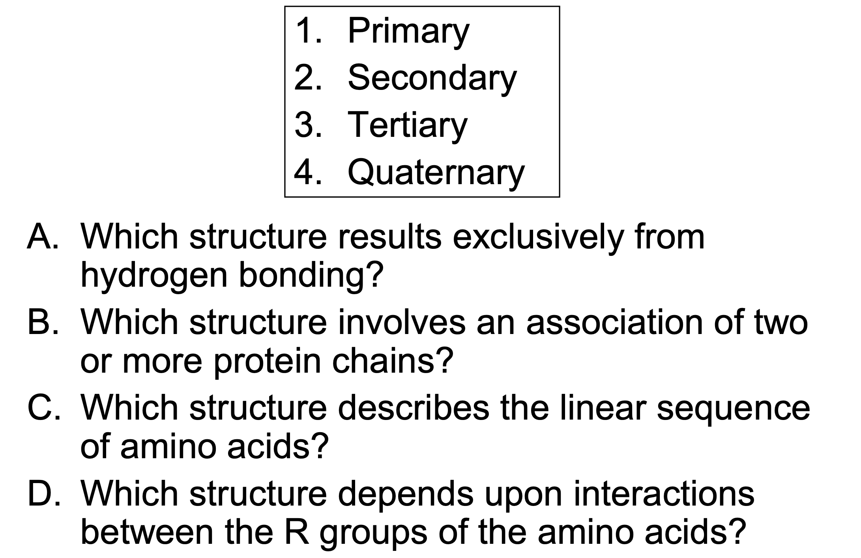
Review Questions
https://www.slideshare.net/SabahatAli9/protein-structure-levels
https://e7.pngegg.com/pngimages/503/822/png-clipart-folding-home-folding-funnel-protein-folding-energy-landscape-levinthal-s-paradox-brief-introduction.png

Slide 13
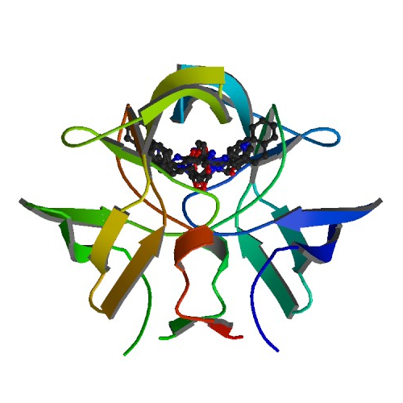
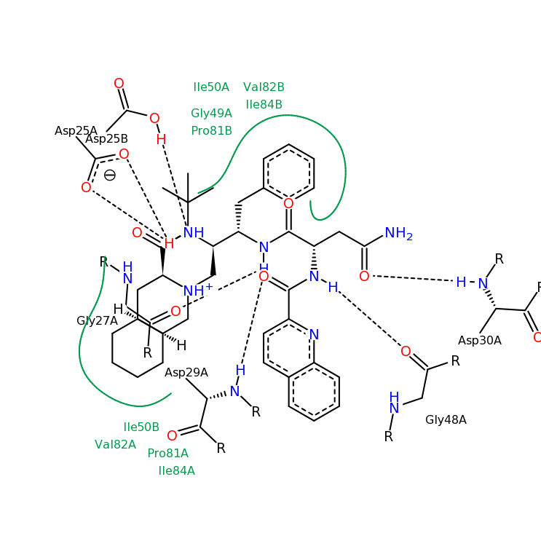
Most drugs are small molecules that specifically interact with the folded structures
HIV protease with saquinavir
HIV protease drugs often cause a flap to fold over the active site
http://www.rcsb.org/pdb/101/motm_disscussed_entry.do?id=1hxb

Slide 14
Most drug-target interactions are noncovalent
The interactions driving drug binding are primarily
steric - van der Waals. atoms like to be close but not too close.
electrostatic - like charges repel and opposite charges attract. H bonding often treated as electrostatic.
Water can play an important role.
Some drugs (like penicillin) bind to their targets covalently.
http://www.rcsb.org/pdb/101/motm_disscussed_entry.do?id=1hxb

Slide 15
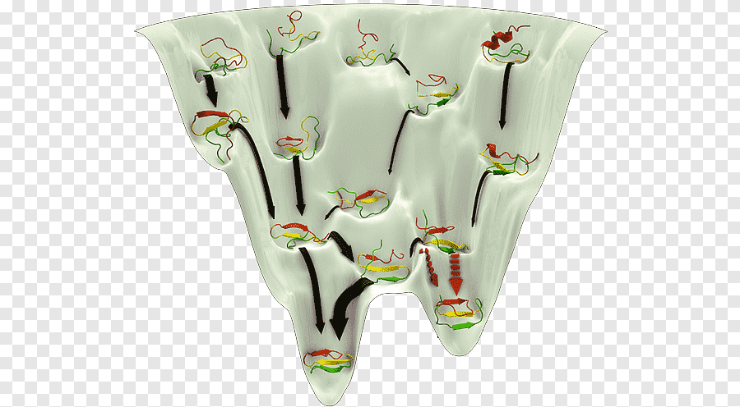
Folding and binding processes are described by energy landscapes
Many configurations are possible
There are many pathways between unfolded configurations
Packing of hydrophobic side chains is a key driver of folding
https://www.pngegg.com/en/png-dyixm

Slide 16
Review Questions
What are biological macromolecules made of?
What does it mean for a biological macromolecule to be folded?
How do most drugs interact with their targets?

Slide 17
Misc
A beautiful short video on “A basic introduction to drugs, drug targets, and molecular interactions”: https://www.youtube.com/watch?v=u49k72rUdyc

Slide 18
Exercise 2: Structural visualization and alignment
colab

